Slide 1
Statistical Methods for Decision Making What do the numbers tell?

Slide 2
Why Study Statistics
Technological developments, Revolution of Internet and social networks, data generated from electronic devices, produce large amount of data
Large storage capacity
Advancement in enormous computing power to effectively process and analyze large amount of data
Better data visualization from Business Intelligence
Discovery of patterns and trends from this data can help organizations gain competitive advantage in marketplace

Slide 3
Types of Statistics
Descriptive statistics is concerned with Data Summarization Graphs/Charts and tables.
Inferential Statistics is the method used to talk about a population parameter from a sample. It involves point estimation, interval estimation, and hypothesis testing.

Slide 4
Some Key Terms
Population is the collection of all possible observations of a specified of characteristic interest.
Sample is a subset of population
Parameter is the population characteristic of interest. For example, you are interested in the average income of a particular class of people. The average income of this entire class of people is called a parameter.
Statistic is based on a sample to make inferences about the population parameter. The average income in of population can be estimated by the average income based on the sample. This sample average is called a statistic.

Slide 5
Types of Data
Data
Categorical (Qualitative)
Numerical (Quantitative)
E.g. Gender, Location of store, Preference
Discrete
Continuous
E.g. Family size, Number of rooms in a hotel, number of credit cards issued
E.g. Waiting time, Length of a part produced

Slide 6
Measurement Scales
Nominal –e.g. Internet service provider
Ordinal: e.g. Bond rating, employee designation
Interval: e.g. IQ Score, Temperature in °C or °F
Ratio: e.g. cost of an item

Slide 7
Measure of central Tendency
You need the summary measures of central tendency to draw meaningful conclusions in the functional area of operation.
The most widely used measures of central tendency are the Arithmetic Mean, Median and Mode.

Slide 8

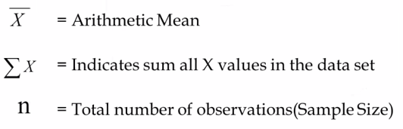
Arithmetic Mean
Arithmetic mean(called Mean) is defined as the sum of all observations in a data set divided by the total number of observations. For example, consider a data set containing the following observations:
In symbolic form mean is given b

Slide 9

Arithmetic Mean - Example
The inner diameter of a particular grade of tire based on 5 sample measurements are as follows: (Figures in millimetres)
565, 570, 572, 568, 585
Applying the formula
We get mean = (565 + 570+572+568+585)/5 =572
Caution: Arithmetic Mean is affected by extreme values or fluctuations in sampling. It is not the best average to use when the data set contains extreme values (Very high or very low values).

Slide 10
Median
Median is the middle most observation when you arrange data in ascending order of magnitude. Median is such 50% of the observations are above the median and 50% of the observations are below the median.
Median is a very useful measure for ranked data in the context Preferences and rating. It is not affected by extreme values (greater resistance to outliers)
Median = (n+1)/2 th value of ranked data.
n = Number of observations in the sample

Slide 11
Median - Example
Marks obtained by 7 students in computer science exam are given below: Compute the median.
45 40 60 80 90 65 55
Arranging the data after ranking them
40 45 55 60 65 80 90
Median = (n+1)/2 th value in this set = (7+1)/2 th observation= 4th observation=60
Hence median = 60 for this problem.

Slide 12
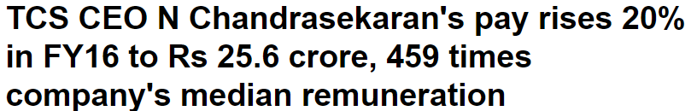

https://economictimes.indiatimes.com/articleshow/52450273.cms?utm_source=contentofinterest&utm_medium=text&utm_campaign=cppst

Slide 13
US median household income climbs to new high
If you're a member of the middle class, chances are things are looking up. Median household income reached a record $61,372 in 2017, up 1.8 percent from $60,309 in 2016.This marks the third year in a row that median household income has gone up, according to the U.S. Census Bureau, which compiled the data.
https://www.cnbc.com/2018/09/12/median-household-income-climbs-to-new-high-of-61372.html

Slide 14

………. Questions about the response time of ambulances dispatched to the stadium were also raised. The head of New South Wales Ambulance was to be hauled before the state health minister Jillian Skinner on Thursday after the ambulance authority issued conflicting statements about their response times. The arrival of the first ambulance took 15 minutes, NSW Ambulance clarified in a statement on Wednesday. The state's median response time for the highest priority life-threatening cases was just under eight minutes in 2013-14, according the authority's statistics……
http://timesofindia.indiatimes.com/articleshow/45292785.cms?utm_source=contentofinterest&utm_medium=text&utm_campaign=cppst

Slide 15
Mode
Mode is that value which occurs most often. It has the maximum frequency of occurrence. Mode also has resistance to outliers.
Mode is a very useful measure when you want to keep in the inventory, the most popular shirt in terms of collar size during festival season.
Caution: In a few problems in real life, there will be more than one mode such as bimodal and multi-modal values. In these cases mode cannot be uniquely determined.

Slide 16
Mode - Example
The life in number of hours of 10 flashlight batteries are as follows: Find the mode
340 340 350 350 340 340 320 340 330 330
340 occurs five times. Hence, mode = 34O.

Slide 17
Comparison of Mean, Median and Mode
Mean Affected by extreme values. Can be treated algebraically. That is, Means of several groups can be combined.
Median Not affected by extreme values. Cannot be treated algebraically. That is, Medians of several groups cannot be combined.
Mode Not affected by extreme values. Cannot be treated algebraically. That is, Modes of several groups cannot be combined.

Slide 18
Measures of Dispersion
In simple terms, of dispersion indicate how large the spread of the distribution is around the central tendency.
It answers unambiguously the equation
“What is the magnitude of departure from the average value for different groups having identical averages?”.

Slide 19
Range
Range is the simplest of all the measures of dispersion. It is calculated as the difference between maximum and minimum value in the data set.
Range = XMaximum – XMinimum

Slide 20
Range -Example
Example for calculating Range
The following data represents the percentage return on the investment for the 10 mutual funds per annum.
Calculate the Range.
12, 14, 11, 18, 11.3, 12, 14, 11, 9
Range = XMaximum – Xminimum = 18 - 9 = 9
Caution: If one of the components of range namely the maximum value or minimum value becomes an extreme value, then range should not be used.

Slide 21
Inter-Quartile Range(IQR)
IQR= Range computed on middle 50% of the observations after eliminating the highest and lowest 25% of observations in a data set that is arranged ascending order. IQR is less affected by outliers.
IQR =Q3-Q1

Slide 22
Interquartile Range-Example
The following data represents the percentage return on investment for 9 mutual funds per annum. Calculate interquartile range.
Data set: 12, 14, 11, 18, 11.5, 12, 14, 11, 9
Arranging in ascending order, the data set becomes
9, 11, 11, 11.5, 12, 12, 14, 14, 18
IQR = Q3 – Q1 = 14 – 11 = 3

Slide 23
Standard deviation
Standard deviation forms the cornerstone for the inferential statistics.
To define standard deviation, you need to define another term called variance. In simple terms, standard deviation is the square root of variance.

Slide 24
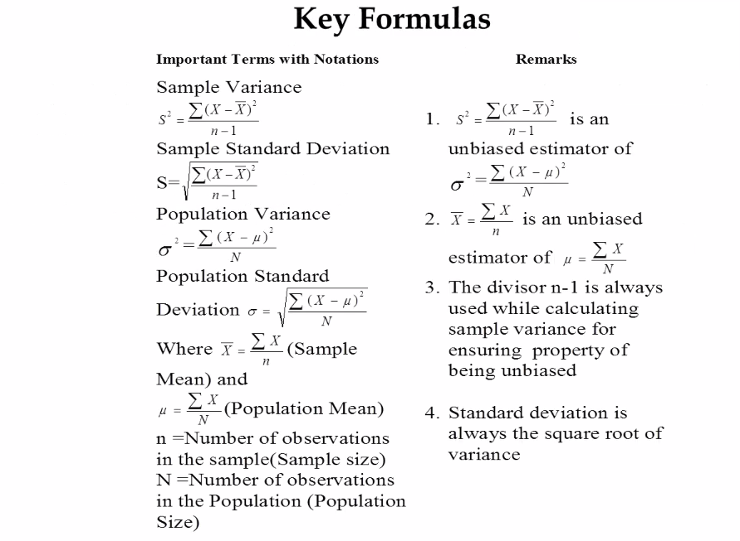

Slide 25
Example of Standard Deviation
The following data represent the percentage return on investment for 10 mutual funds per annum. Calculate the sample standard deviation.
12, 14, 11, 18, 10.5, 11.3, 12, 14, 11, 9

Slide 26
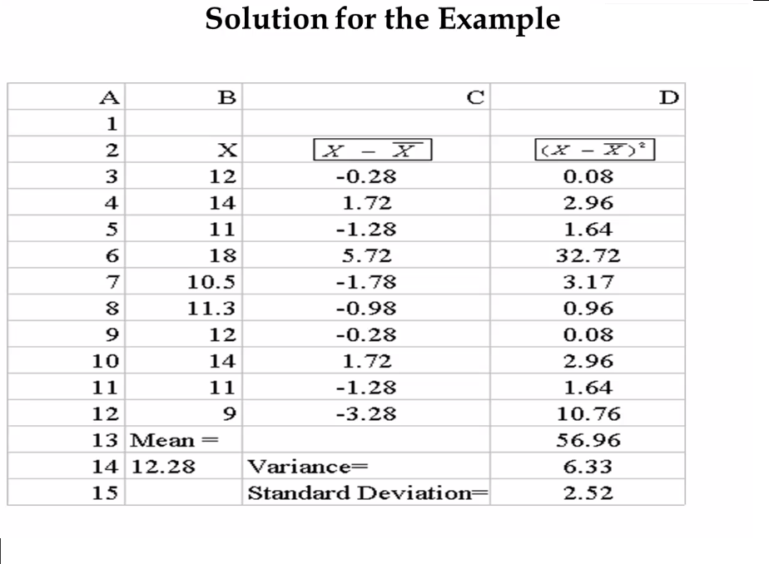

Slide 27



Solution for the example cont.
Form the spreadsheet of the Microsoft excel in the previous slide, it is easy to see
that Mean = = 12.28 ( In column A and row14, 12.28 is seen)
Sample variance = = 6.33 ( In column D and row14, 6.33 is seen)
Sample standard deviation = = 2.52 ( In column D and row15, 2.52 is seen)

Slide 28
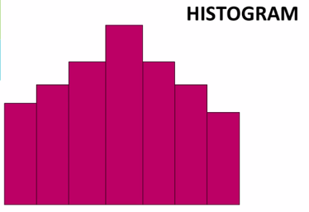
Histogram( also known as frequency histogram) is a snap shot of the frequency distribution.
Histogram is a graphical representation of the frequency distribution in which the X-axis represents the classes and the Y-axis represents the frequencies in bars.
Histogram depicts the pattern of the distribution emerging from the characteristic being measured.

Slide 29

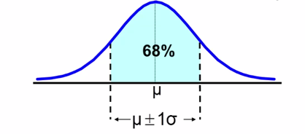
The Empirical Rule
The empirical rule approximates the variation of data in the bell-shaped distribution.
Approximately 68% of the data in a bell shaped distribution is within 1 standard deviation of the mean or

Slide 30
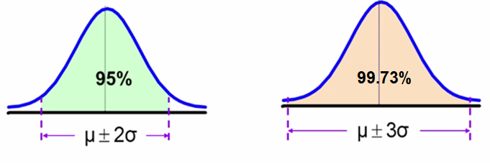
The Empirical Rule
Approximately 95% of the data is a bell-shaped distribution lies within two standard deviations of the mean, or
Approximately 99.73% of the data is a bell-shaped distribution lies within three standard deviations of the mean, or

Slide 31
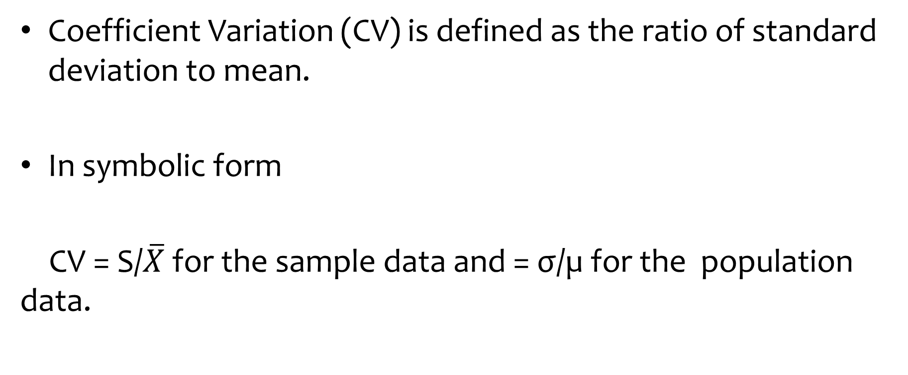
Coefficient of Variation (Relative Dispersion)
Coefficient Variation (CV) is defined as the ratio of standard deviation to mean.
In symbolic form
CV = S/$\overline{X}$ for the sample data and = σ/µ for the population data.

Slide 32
Coefficient of Variation Example
Following is the performance of two Sales Teams in terms of monthly sales
Comment on the results.
Sales Team 1
Standard deviation: 10 units
Sales Team 2
Standard Deviation 12 units

Slide 33
Coefficient of Variation Example
Additional information
Sales Team 1
Mean: 70 units
Sales Team 2
Mean: 120 units

Slide 34
Interpretation for the Example
The CV for Team 1 is 10/70 = 0.14 or 14%
The CV for Team 2 is 12/120 = 0.10 or 10%

Slide 35
The five number summary
The five numbers that help describe the center, spread and shape of the data are:
XSmallest
First Quartile (Q1)
Median (Q2)
Third Quartile (Q3)
XLargest

Slide 36
CASE STUDY - HEALTH INSURANCE
Most companies are now recognizing the power of data in making crucial business decisions. For an Insurance company, it becomes more important to study various attributes about their customers. Leveraging this customer information to make business decisions can provide a competitive edge to the company over other players in the market
We are provided with some customer data of an Insurance company like age, gender, BMI and medical charges billed by insurance company. We need to explore this data to see if we can derive some meaningful insights from this data.
Notes:
Product – catg
Age – continuous
Usage
Fitness: Interval
Miles: Ratio

Slide 37
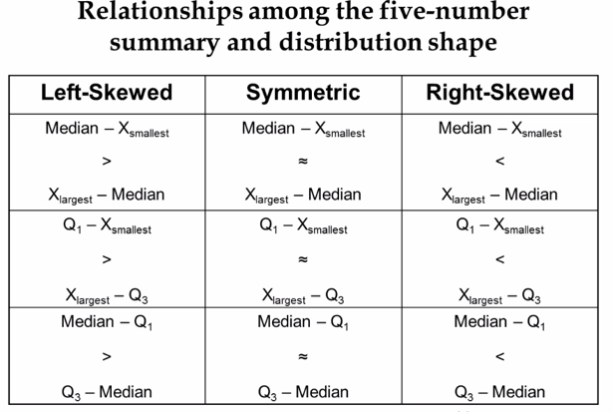

Slide 38
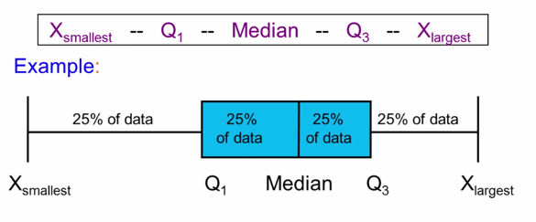
Five number summary and The Boxplot
The Boxplot: A graphical display of the data on the five-number summary:

Slide 39
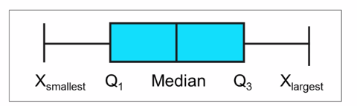
Five number summary: Shape of Boxplots
If data is symmetric around the median then the box and central line are centered between the endpoints.
A Boxplot can be shown in either a vertical or horizontal orientation.

Slide 40
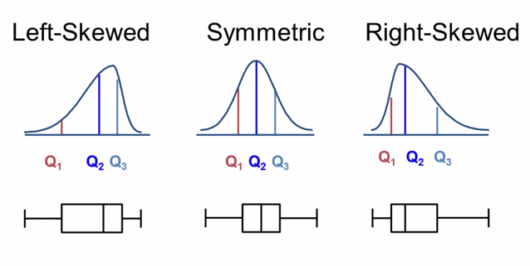
Distribution shape and The Boxplots

Slide 41
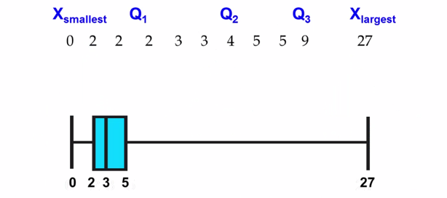
Boxplot Example
Below is a Boxplot for the following data:
The data are right skewed, as the plot depicts

Slide 42
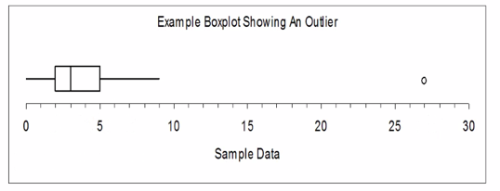
Boxplot example showing an outlier
The Boxplot below of the same data shows the outlier value of 27 plotted separately.
A value is considered an outlier if it is more than 1.5 times the interquartile range between Q1 or above Q3.

Slide 43
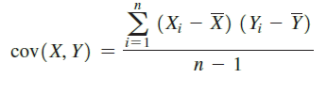
Covariance
The covariance measures the strength of the linear relationship between two numerical variables (X and Y). Formula for sample Covariance is
Drawback of covariance: It can have any value, so it cannot be used to determine the relative strength of the relationship

Slide 44

Coefficient of Correlation
Coefficient of correlation (r) measures the relative strength of a linear relationship between two numerical variables.
The values r range from -1 to + 1
The value -1 indicates a perfect negative correlation and +1 indicates a perfect positive correlation

